Slide 1


Slide 2

Notes:
So who are we?
An open and inclusive forum of likeminded geo-geeks who love working with location data (and have done so for years) and want to share their knowledge
We hold regular meetups at pubs where anyone can share their love of geo and their geo-related stories
Why was GeoRabble formed? - The traditional geospatial industry is dominated by vendors and agendas
Who move at their pace – too slow for new tech like AR

Slide 3
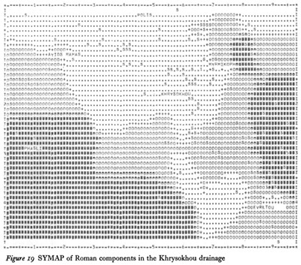
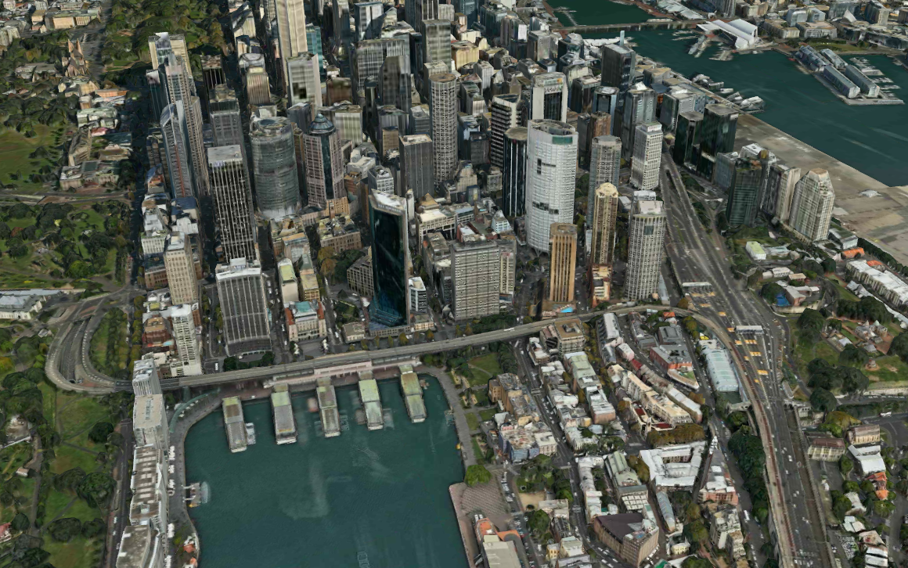
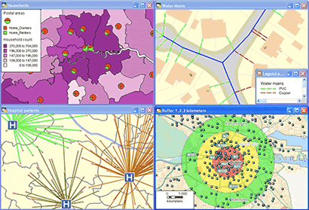
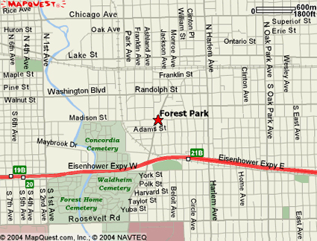
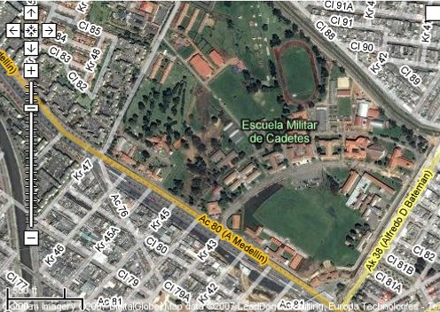

Notes:
Some context - a brief history of Geo:
1 - ASCII maps
2 – Desktop mapping
3 – web maps
4 – Tiled mapping, APIs, aerials
5 – 3D
6 – AR

Slide 4

Notes:
It’s an industry dominated by closed data and proprietary software

Slide 5
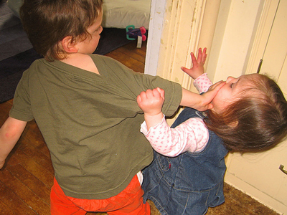
Notes:
– they don’t share very well

Slide 6

Notes:
A traditional geospatial industry conference – lots of sell not enough user stories

Slide 7

Notes:
So we had an idea

Slide 8

Notes:
To create a forum for users of location information so their stories could be heard,
so their achievements and knowledge could be shared

Slide 9

Anybody Can Present
No Sales Pitches
Up to 10 mins
Use Any Medium
Notes:
At our meetups anyone can talk about anything geo related free of sales pitches and agendas (plugs for startups are ok)

Slide 10
Peter Bayley
Stewart Hay @OhMyDeity
Tim Leigh
Hugh Saalmans @minus34
@georabble
info@georabble.org
Notes:
So who’s here from GeoRabble ...
We’re always contactable by Twitter and email

Slide 11

Notes:
Why are we here?
We’re here to help you work with location data and lubricate your geo thinking

Slide 12
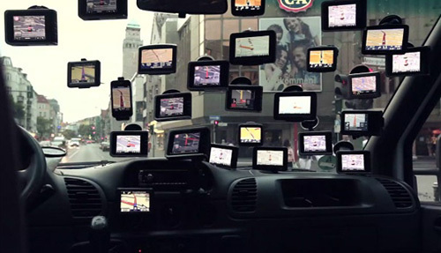
Notes:
A massive proliferation of location data
80% of your apps will have location content in them

Slide 13
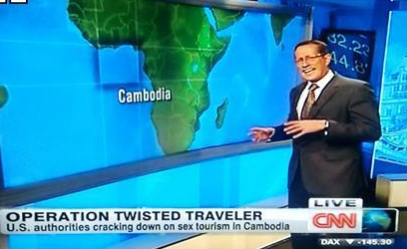
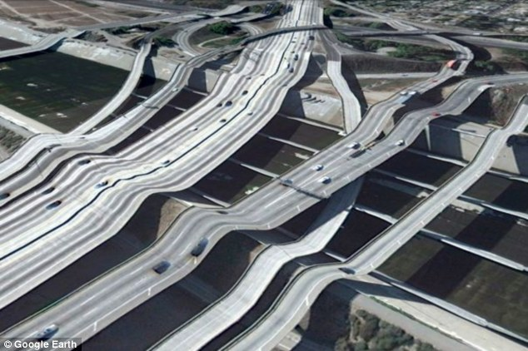
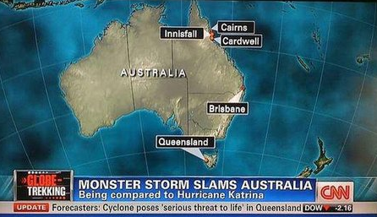
Notes:
And avoid doing this

Slide 14


Notes:
Some thoughts to stimulate your geo-thinking

Slide 15
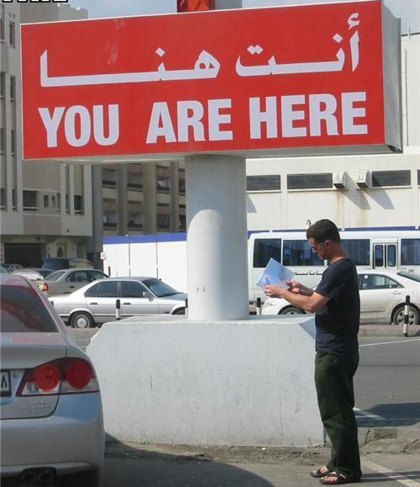
More than Location
Notes:
Geospatial is now more than just location

Slide 16
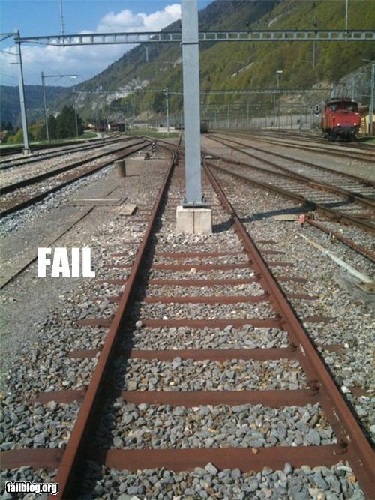
Value of Understanding Place
Tobler’s 1st Law of Geography
Notes:
It’s about understanding the value of a location to someone

Slide 17
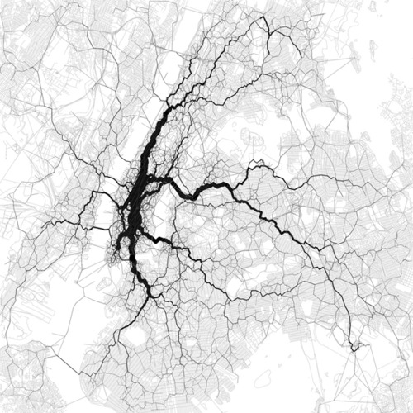
New Insights and Data Sources
Eric Fischer: New York City by Geotagged Tweets
Notes:
It’s about understanding the relationship between locations

Slide 18
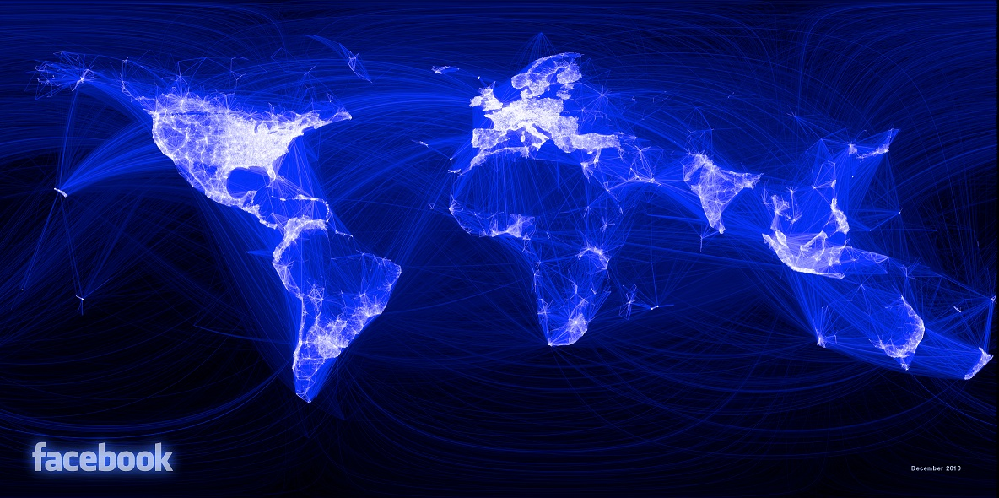
New Insights and Data Sources
Eric Fischer: New York City by Geotagged Tweets
Notes:
It’s about understanding the relationship between people

Slide 19
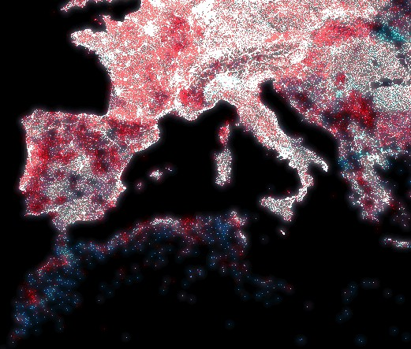
The Digital Divide
Gregor Aisch – location of IP addresses vs population.
Notes:
It’s about uncovering trends that were previously hidden in Excel spreadsheets and databases

Slide 20
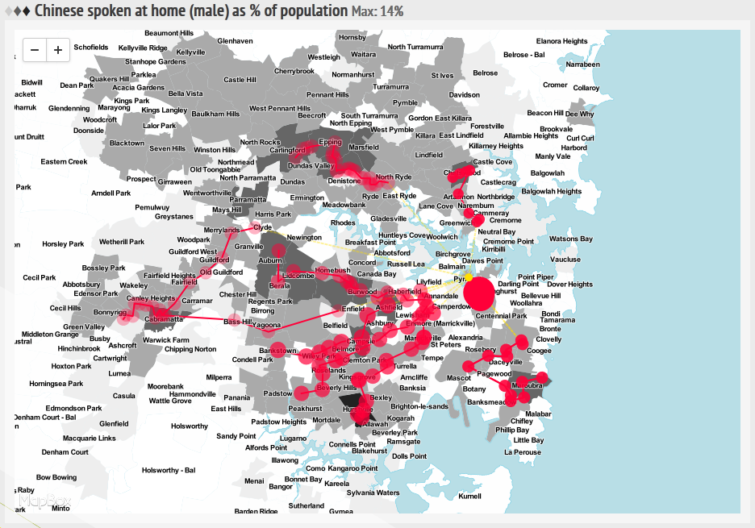
The Cattle Drive
Jack @ Small Multiples: shuttle bus routes targeting vulnerable communities
Notes:
It’s about uncovering dubious corporate activities

Slide 21
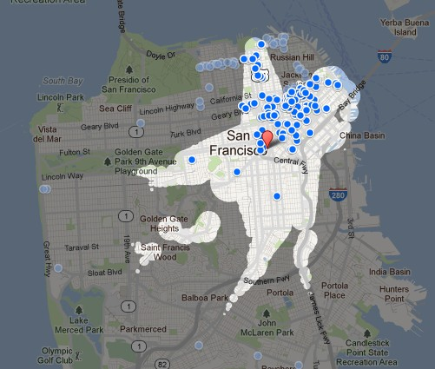
More than Pushpins
20 min travel time Isochrones in Google Hotel Finder
Notes:
It’s about giving users simple access to powerful geoprocessing...

Slide 22
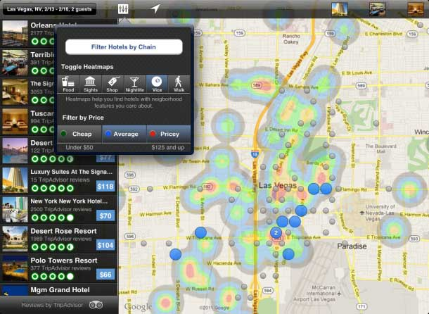
Hipmunk
Restaurant Density
Notes:
...to make decisions

Slide 23
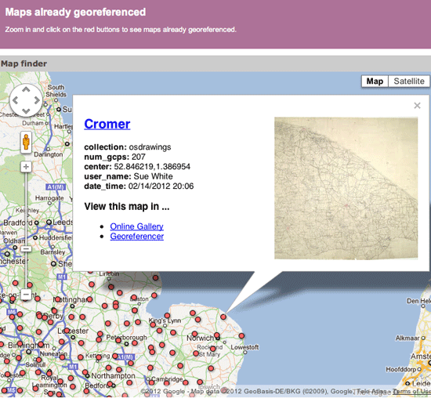
Crowdsourced Georeferencing
British Library
Notes:
It’s about easy access to volumes of crowdsourced data

Slide 24
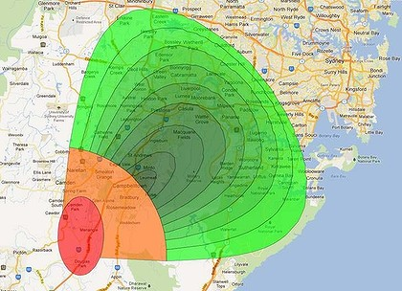
Budget Direct
Hail Automated Notification System (HANS)
Notes:
Lastly, it’s about protecting life and property with timely, accurate information

Slide 25
Deloitte Tech Trends 2012
Top 5 Enablers
Big Data Goes to Work
Geospatial Visualisation
Digital Identities
Measured Innovation
Outside-in Architecture
Notes:
No surprise here

Slide 26
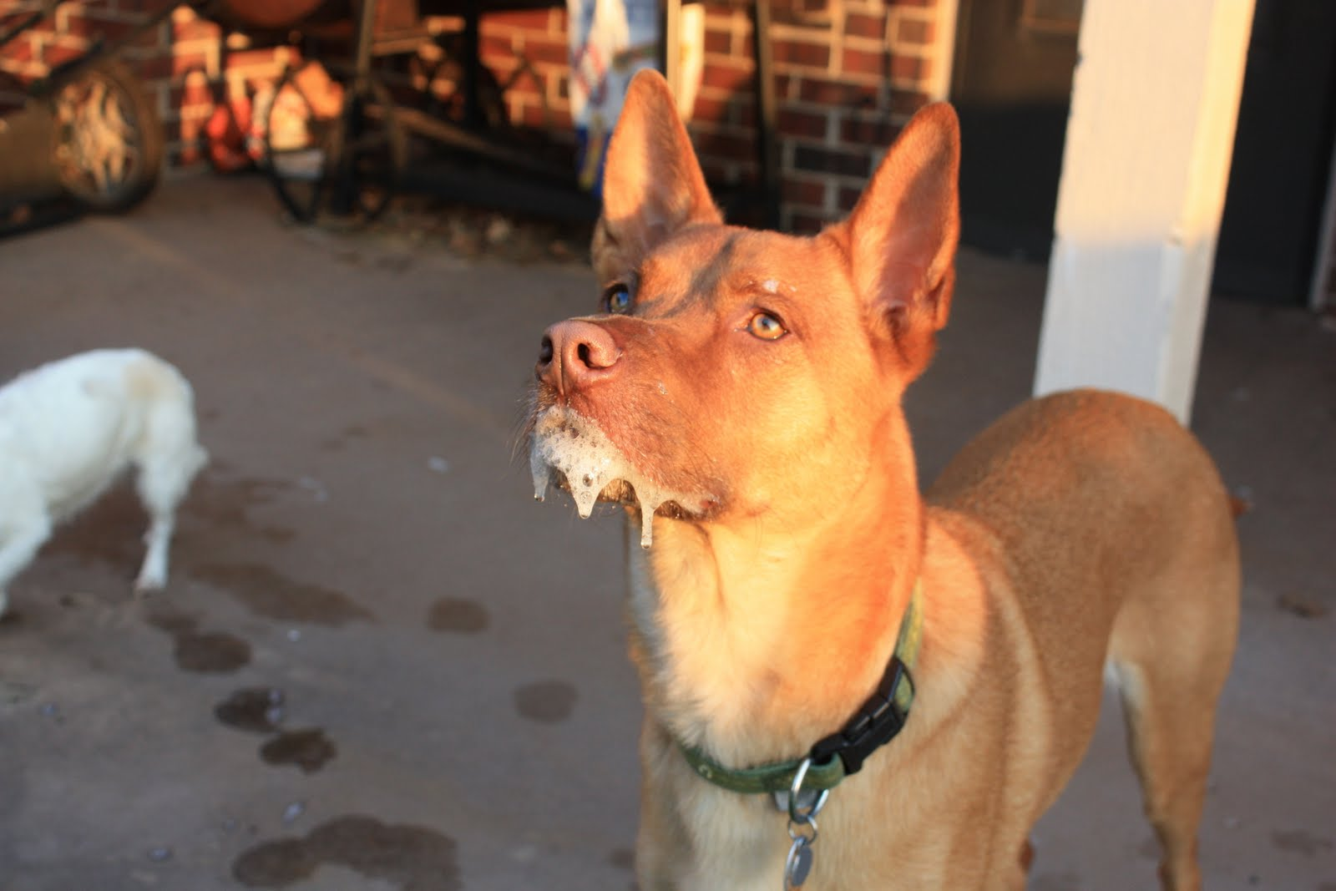
Notes:
So now you’re keen to get stuck in to some geo-goodness – where do I start?

Slide 27
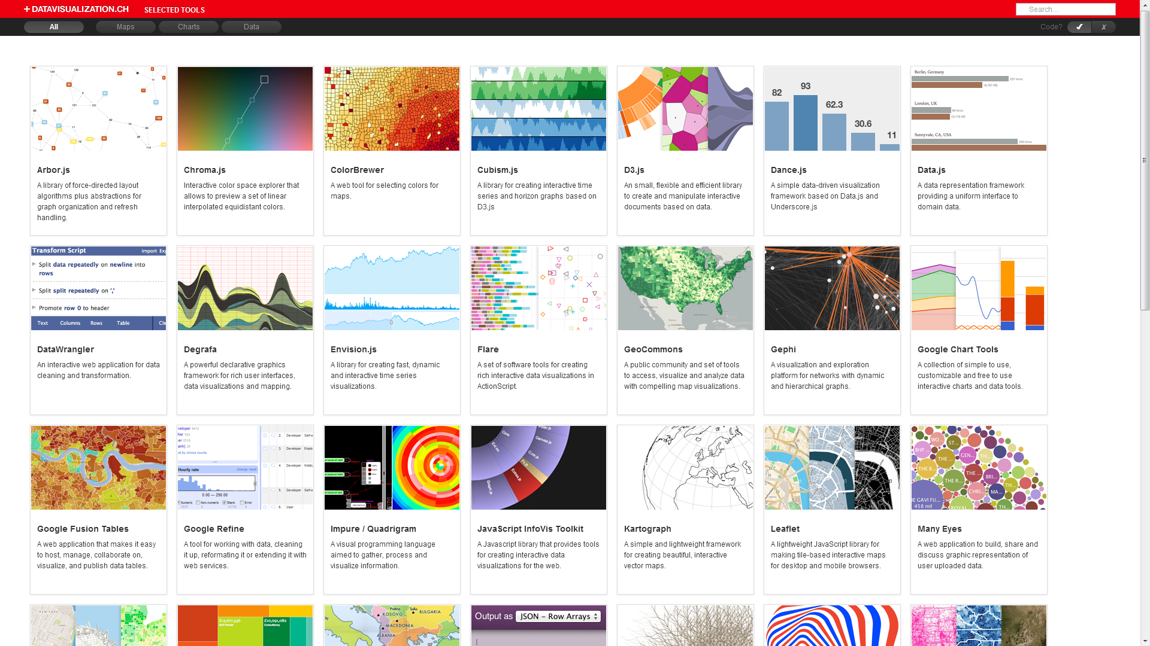
http://selection.datavisualization.ch/
Notes:
There are tonnes of visualisation tools out there

Slide 28




T H E F R O N T E N D
Notes:
Google Maps was the game changer for the industry – now has 25,000 map load limit per day
Openlayers – powerful but bit fiddly
Leaflet – simple to implement – has the fundamentals you need to visualise static and dynamic data
Mapbox all in one map generator – but only comes with 3000 free maps!

Slide 29


T H E B A C K E N D
Notes:
GeoServer gives you the capability to merge and share geodata from different sources using open standards – WMS, WFS
PostGIS is the DB for storing and analysing geodata
Other DBs include SQLite, CouchDB and MongoDB

Slide 30
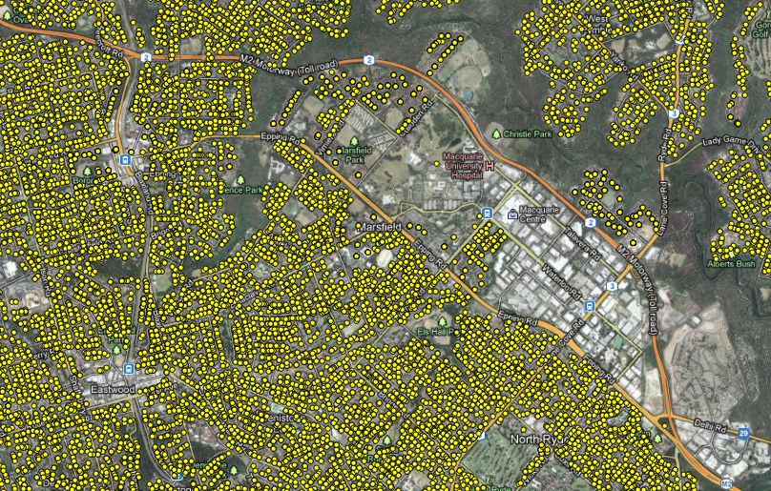
W O R K I N G W I T H T H E D AT A

Slide 31
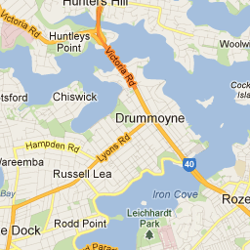
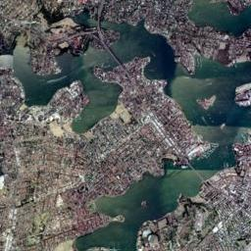
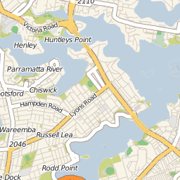
B A S E M A P S
http://msdn.microsoft.com/en-us/library/bb259689.aspx
Notes:
There are Google basemaps and OpenStreetMap based Cloudmade basemaps – static, not interactive!
This MS site explains the tile mapping system

Slide 32
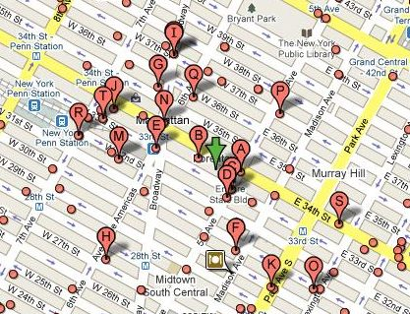
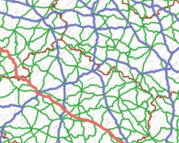
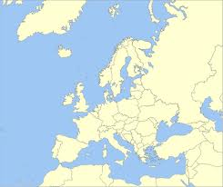
D O T S , L I N E S & B O U N D A R I E S
Dots – POIs, user or friend locations, tweets ...
Lines – streets, relationships, linkages ...
Boundaries – suburbs, postcodes, zones ...
Notes:
If you want to add some interactive or dynamic content – you’ll need some of this

Slide 33

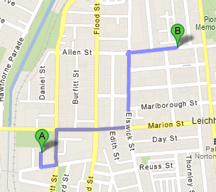
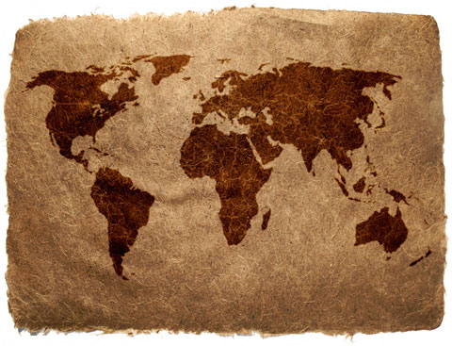
G E O P R O C E S S I N G
Geocoding:
converting text addresses to usable locations
Routing:
directions between 2 or more locations
Georeferencing:
applying real world coords to non-geo data
Notes:
Google have good geocoding and routing services
Georeferencing can be done inside an OS desktop tool like Quantum GIS

Slide 34
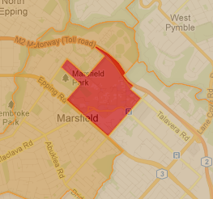
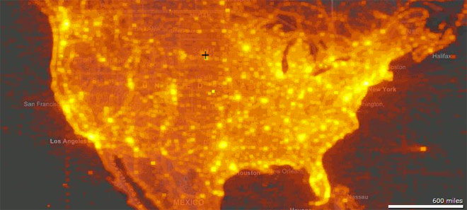
M A P S
Choropleth – maps shaded by a dataset ...
Heat – density maps ...
Notes:
Apart from just plain maps with some data on them...

Slide 35
C O O K B O O K
I N G R E D I E N T S
ABS Census 2006 bdys & stats (BY-CC)
PostGIS 2.0
PHP
Leaflet
Cloudmade OSM tiles
> See the GeoRabble Blog for more...

Slide 36
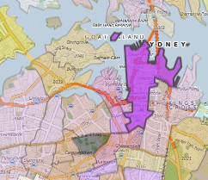
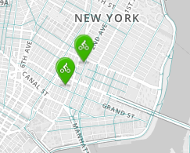
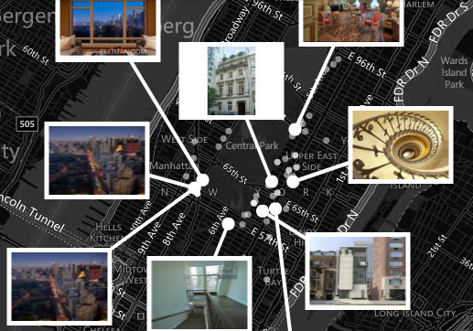
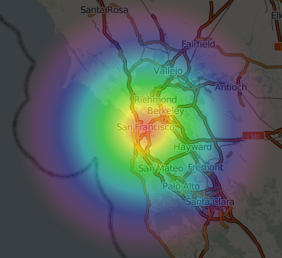
E X A M P L E S

Slide 37
T I P S
Coordinate Systems:
AU data will most likely be GDA94 = WGS84
(SRID : 4326)
Vector Thinning:
Rich line and bdy datasets need to have their coords thinned for web & mobile display (for each zoom level)
GeoJSON:
The de-facto JS standard for distributing geodata to end users (drop the decimal places)
Notes:
Thinning functions are in PostGIS and desktop OS tools like Quantum GIS
Prepping static GeoJSON data, optimised for each zoom level is key for performance
PostGIS should be fast enough to thin and output to GeoJSON on the fly

Slide 38
M A P R U L E S
O N E M A P , O N E P U R P O S E ( K I S S )
M A N Y D O T S
M A N Y L A Y E R S
M A N Y W I D G E T S
= M A N Y C O N F U S E D U S E R S

Slide 39


Over 700 people have
come along and connected:
50 Presentations
4 Sydney GeoRabbles
2 Melbourne GeoRabbles
2 Perth GeoRabbles
1 Brisbane GeoRabble
Next Events: Sydney July (tba)
Canberra coming soon
Notes:
The next GeoRabble meetups are coming up
We’d love to see you there to share your geo stories
And we’d love to invite the winners of the GovHack geo based awards to present

Slide 40

Notes:
So when you wake up tomorrow – we want you to be thinking location , and thinking what could you achieve with geodata
Good hacking everyone and thank you

